Slide 1

Ruby

Slide 2




Dilum Navanjana
Senior Software Engineer
99x Technology
DilumN@99x.lk
dilumn_
dilumn

Slide 3


Slide 4
There are numerous programming languages

Slide 5
But what we love most is..

Slide 6
Ruby

Slide 7
But what is Ruby?

Slide 8
Ruby the syntax

Slide 9
Ruby the philosophy

Slide 10
Ruby the library

Slide 11
Ruby the gems

Slide 12
Ruby the community

Slide 13
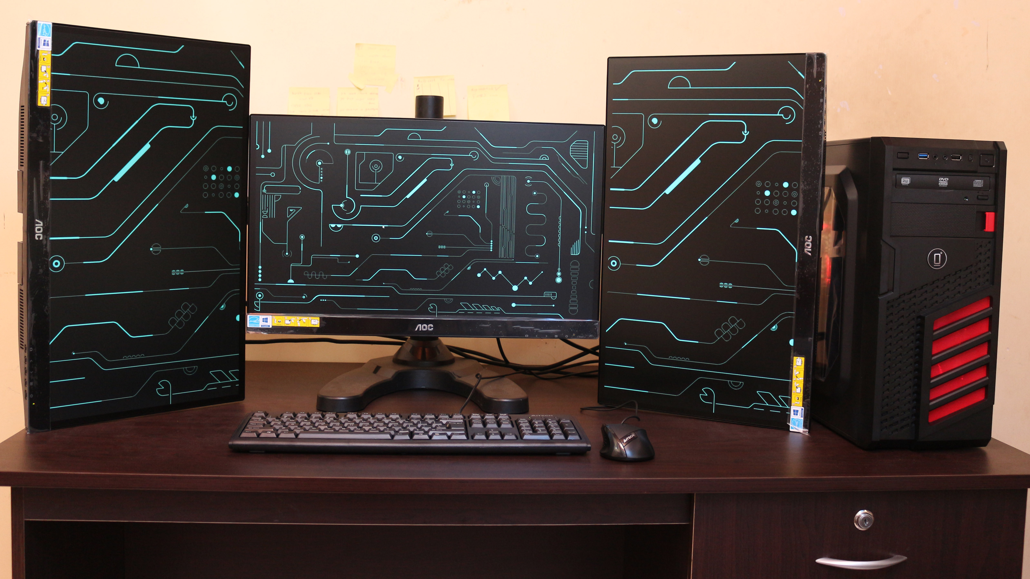

Slide 14
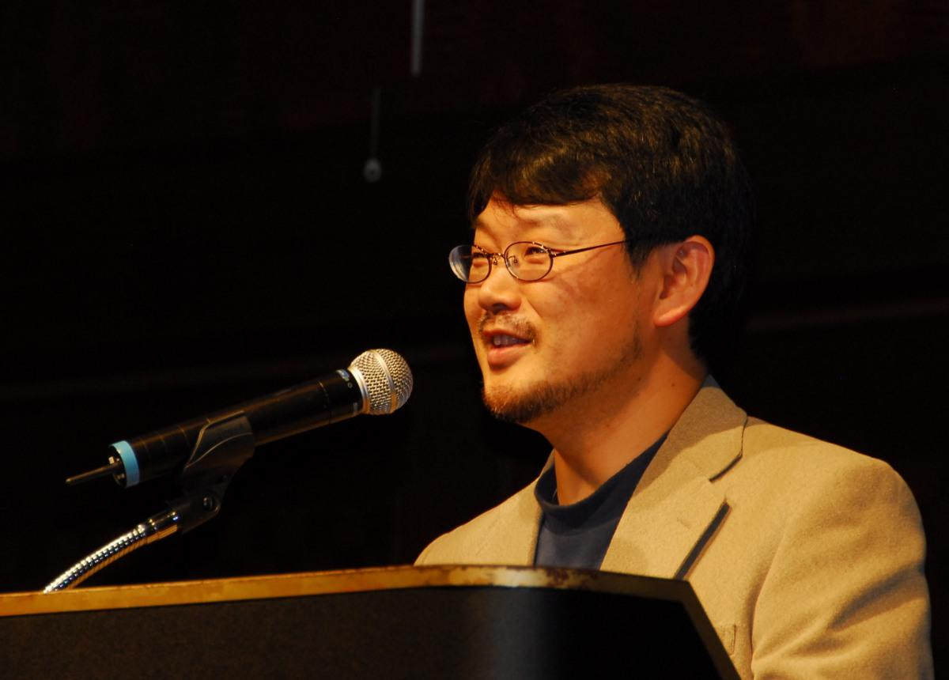
Yukihiro Matsumoto
“Ruby is simple in appearance, but is very complex inside, just like our human body” - Yukihiro Matsumoto

Slide 15
Ruby versions
Ruby MRI
JRuby
goruby
Rubinius

Slide 16
Basic features
Classes, Inheritance
Threads
Cross Platform
Garbage Collection
Exception Handling
Object Oriented
Regular Expressions
Variables are not typed
Powerful string operations

Slide 17
Awesome Ruby
It’s beautiful

Slide 18
It’s beautiful
puts “Hello World”

Slide 19
It’s beautiful
a = 5
b = “HI”

Slide 20
Awesome Ruby
Everything is an object

Slide 21
Everything is an object
a = 5
a.class //Fixnum

Slide 22
Everything is an object
5.times { puts "Hello" }

Slide 23
Awesome Ruby
Duck Typing
If an object walks like a duck and talks like a duck, then the Ruby interpreter is happy to treat it as if it were a duck.

Slide 24
Awesome Ruby
open classes

Slide 26
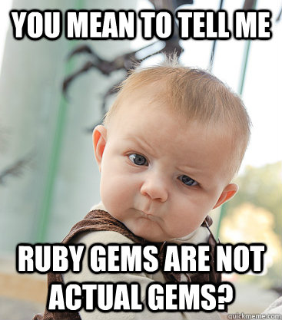
Awesome Ruby
gems

Slide 27
gems
You can create your own gem
bundle gem GEMNAME

Slide 28
Demo

Slide 29
Part II

Slide 30
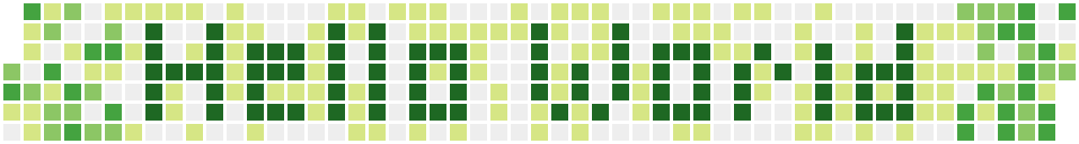

Slide 31
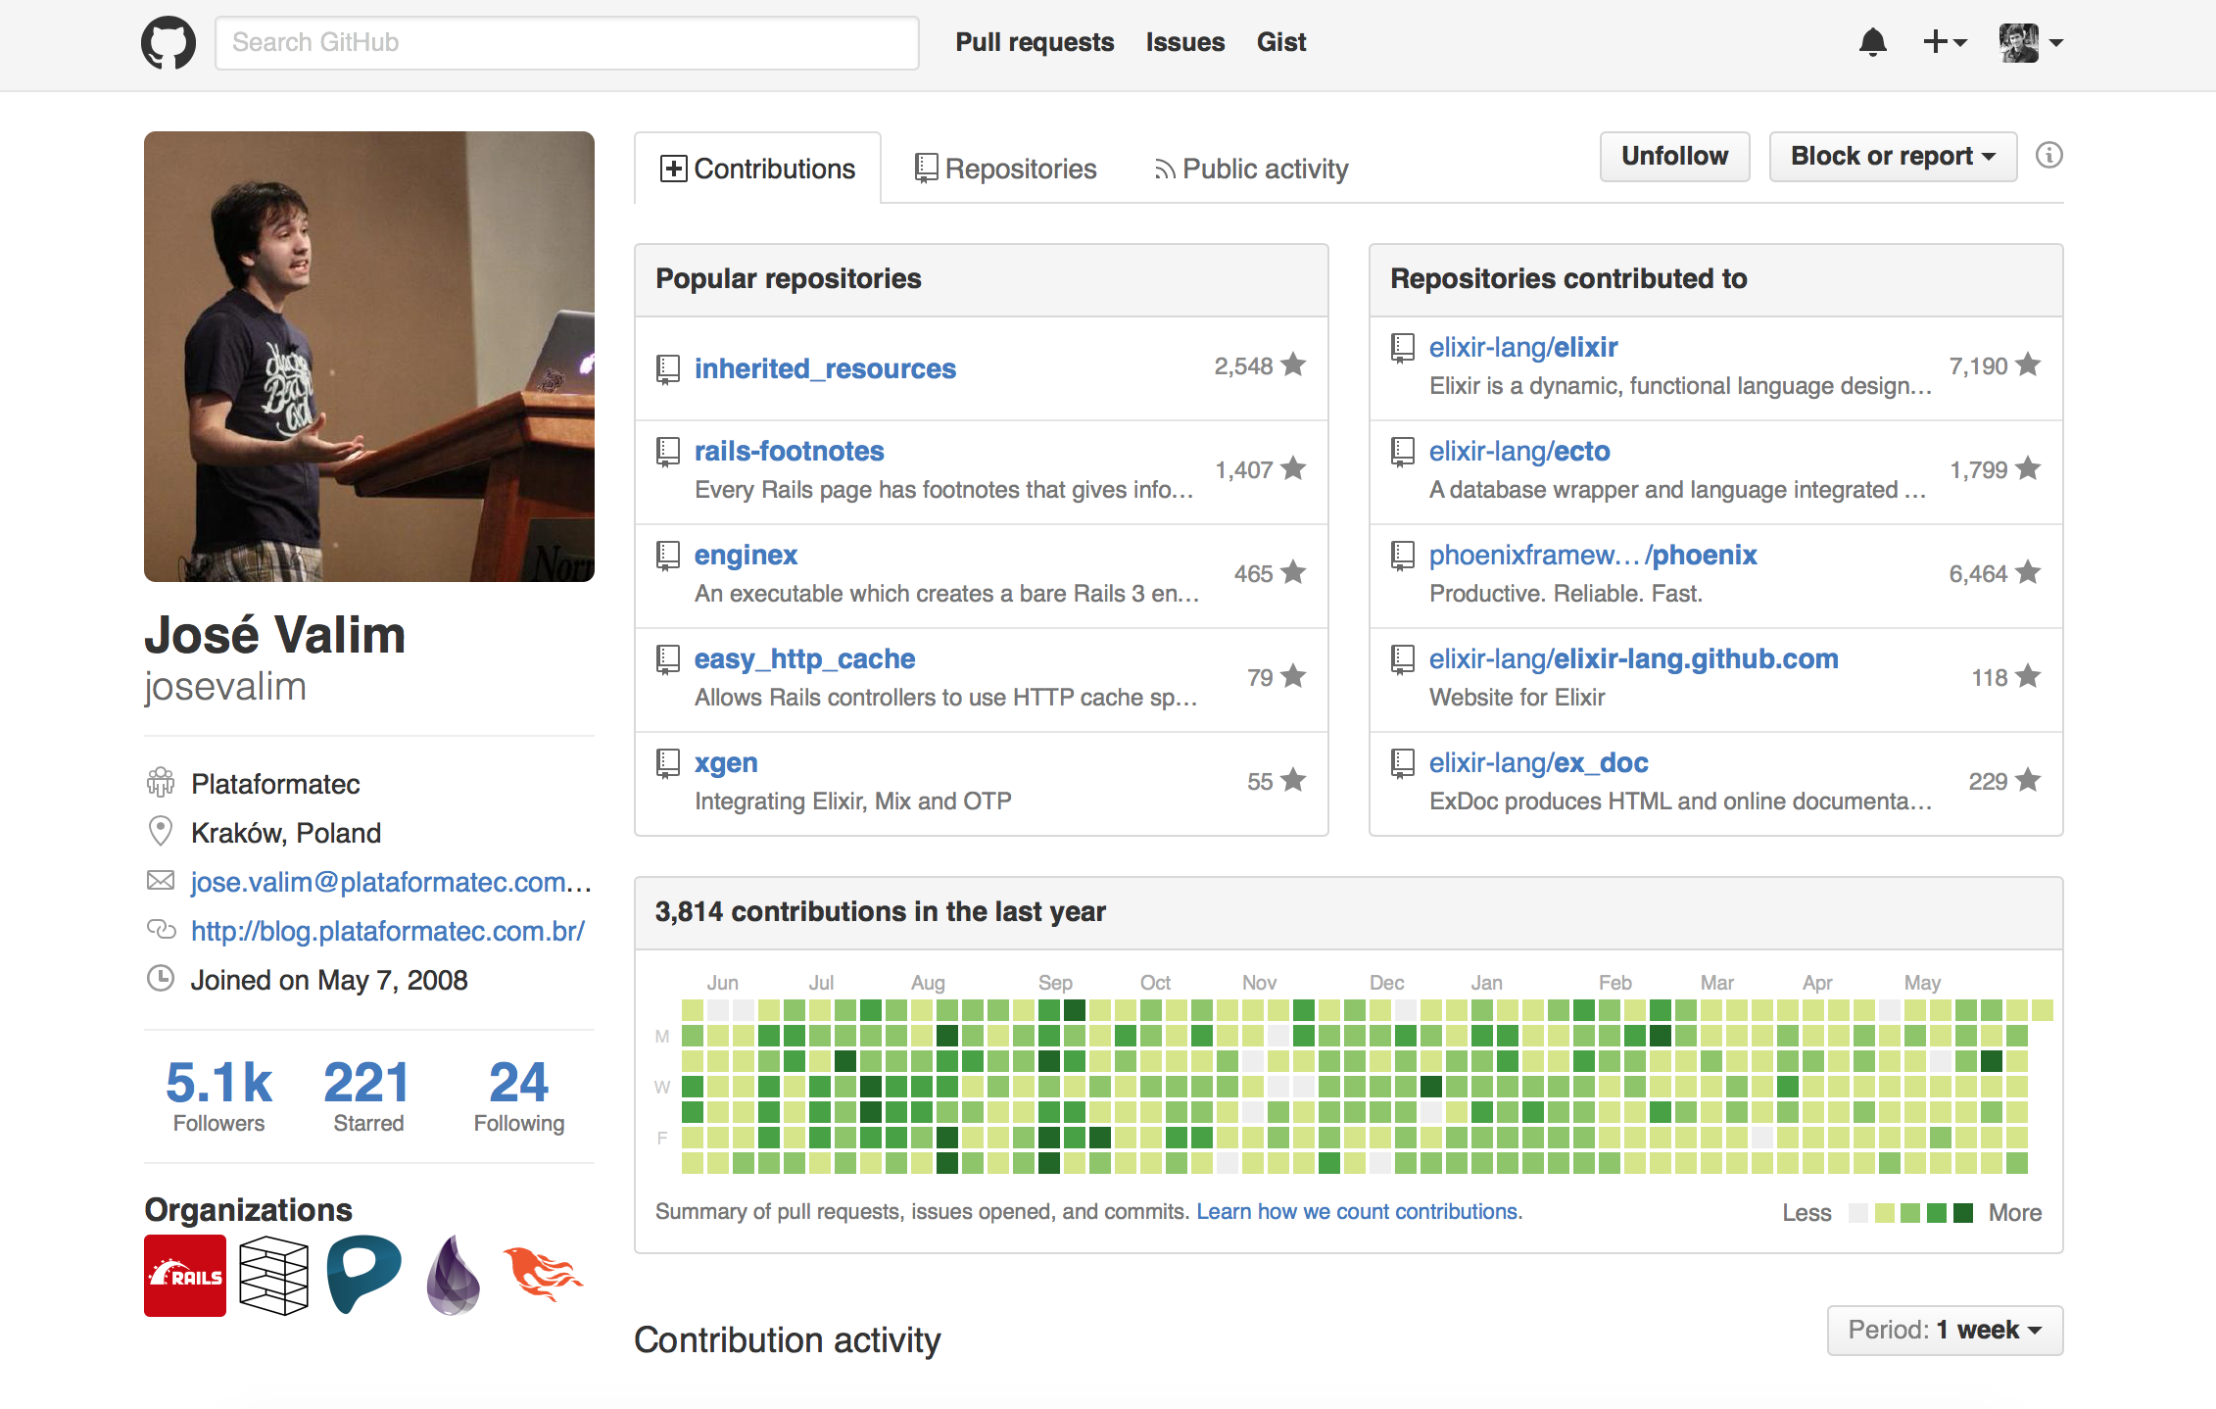

Slide 32
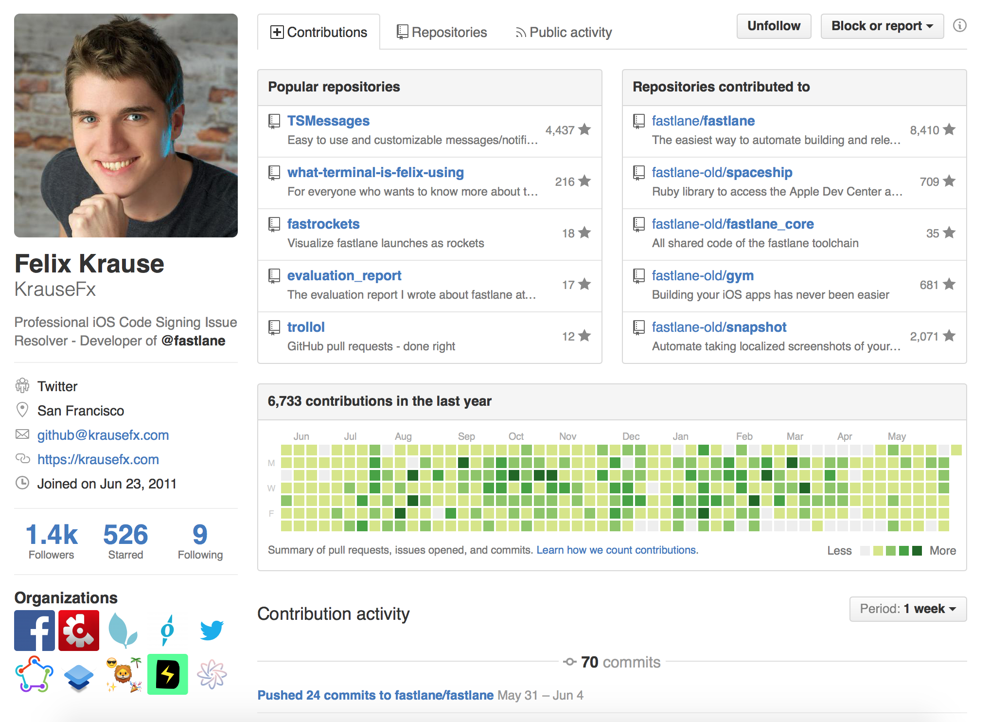

Slide 33
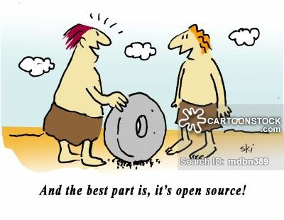
What if we didn’t have Open Source

Slide 34
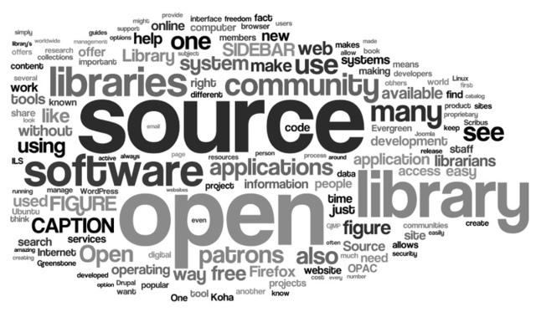
Use Open Source Software

Slide 35
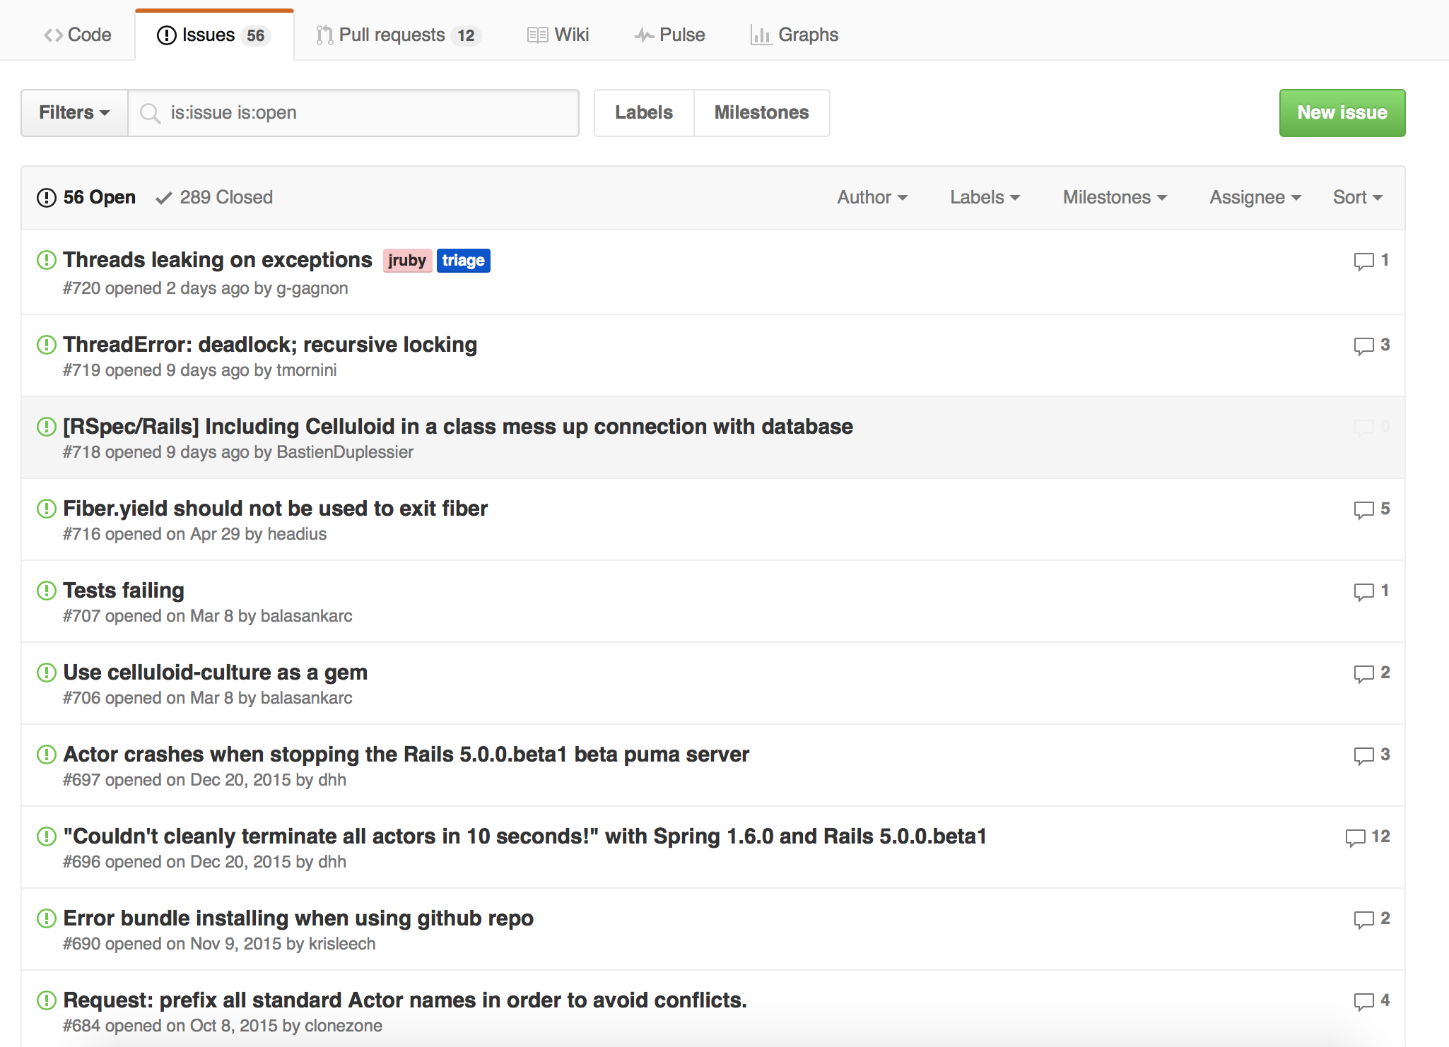
2. Report bugs if you find while using

Slide 36
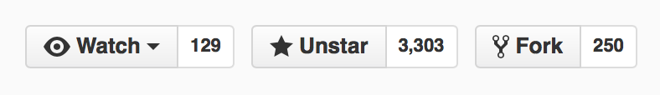
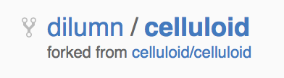
3. Start with small patches to gain confidence
Fork the repository

Slide 38
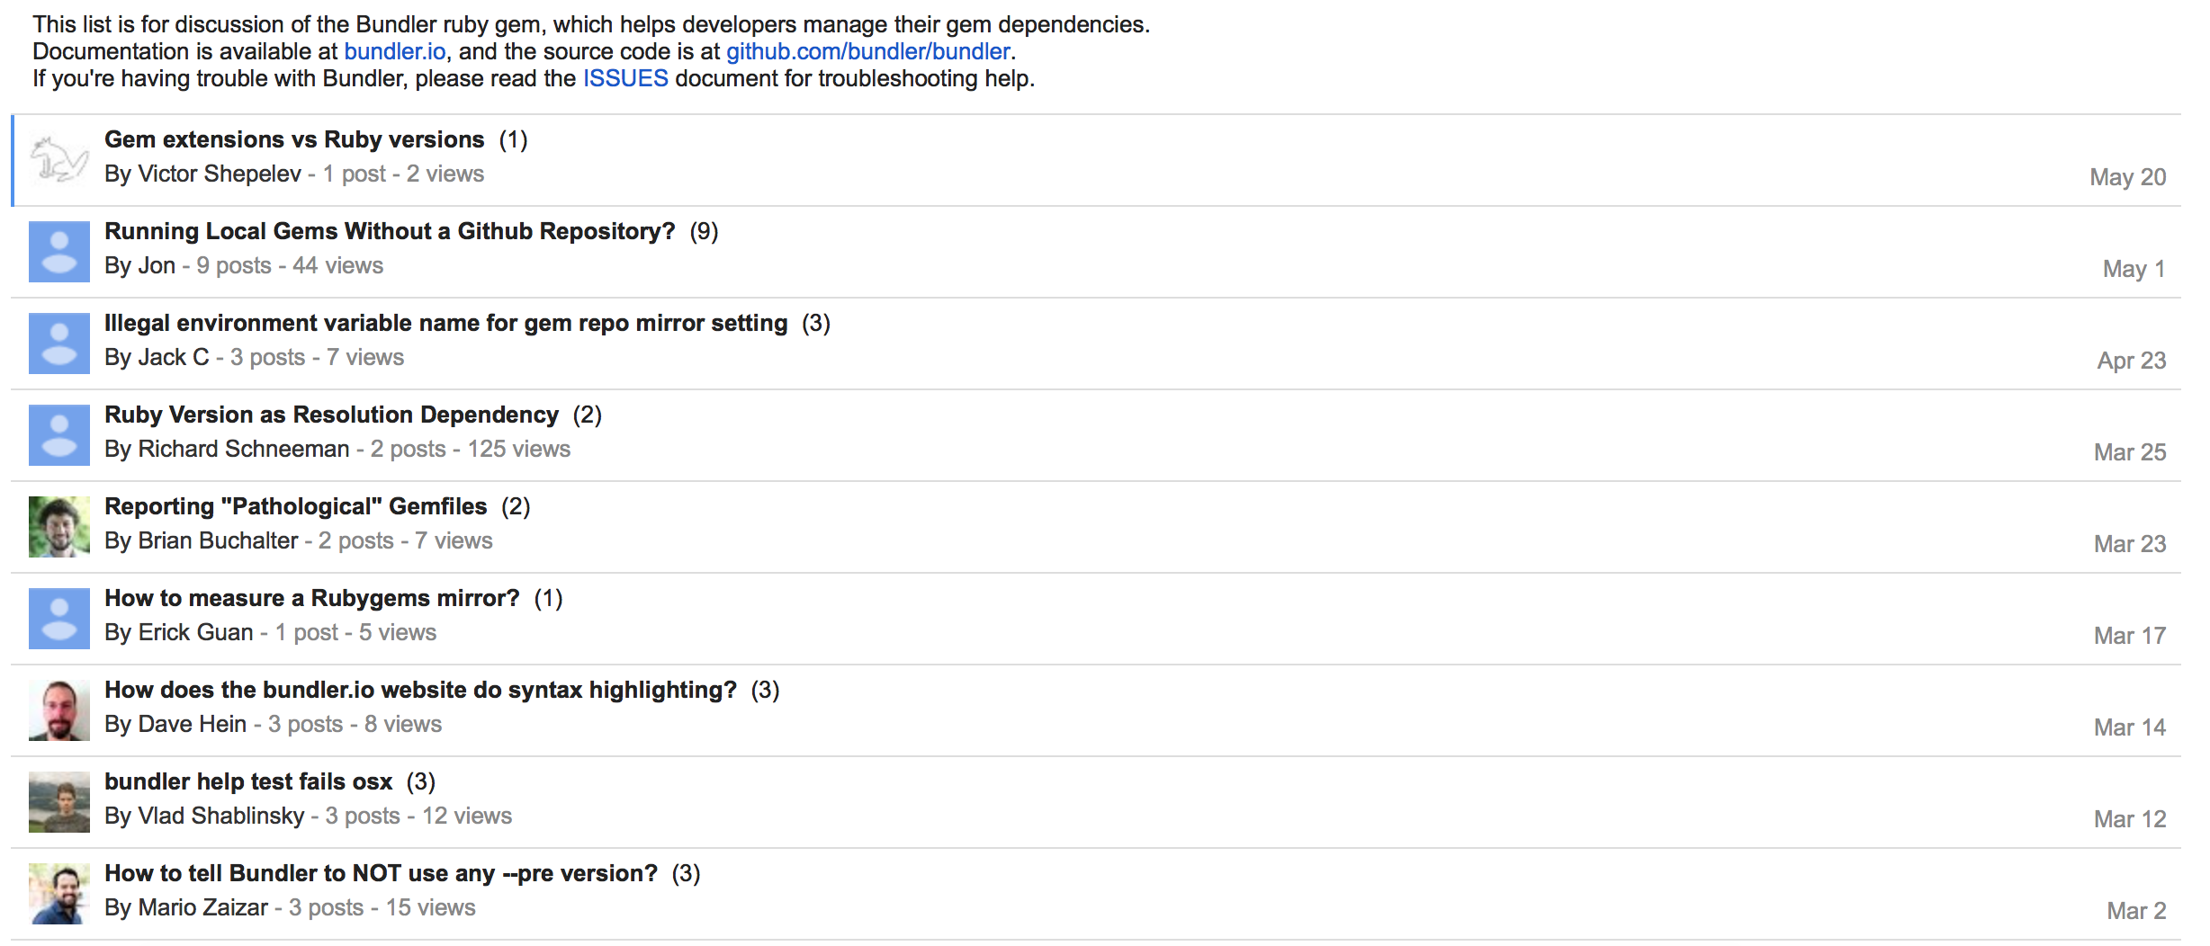
4. Participate in the mailing list / bug reporter to answer questions

Slide 39
5. Make larger patches

Slide 40
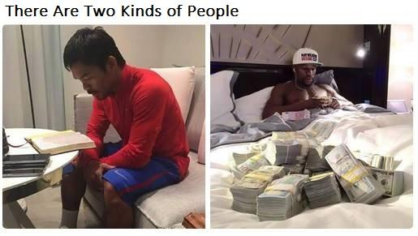
Money matters

Slide 41
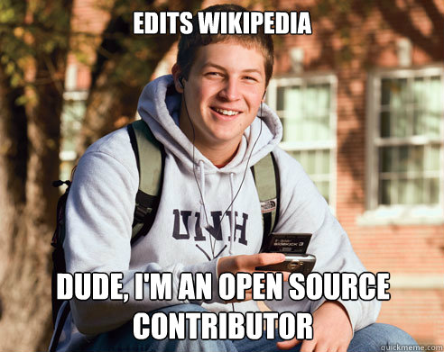
Benefits of become an Open Source Contributor

Slide 42

Google Summer of Code

Slide 43


Slide 44
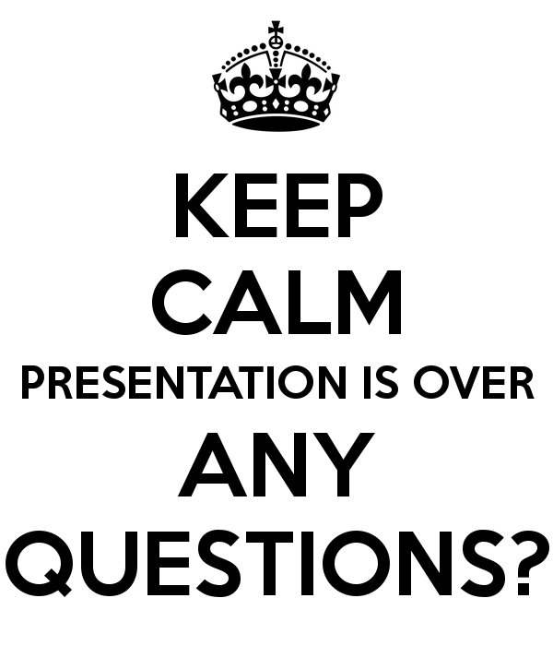

Slide 45
Thank you….
dilumn_

